Slide 1
Subsea Services Inc.
Website Development
Round 2 Comments
12 Sep 2016

Slide 2
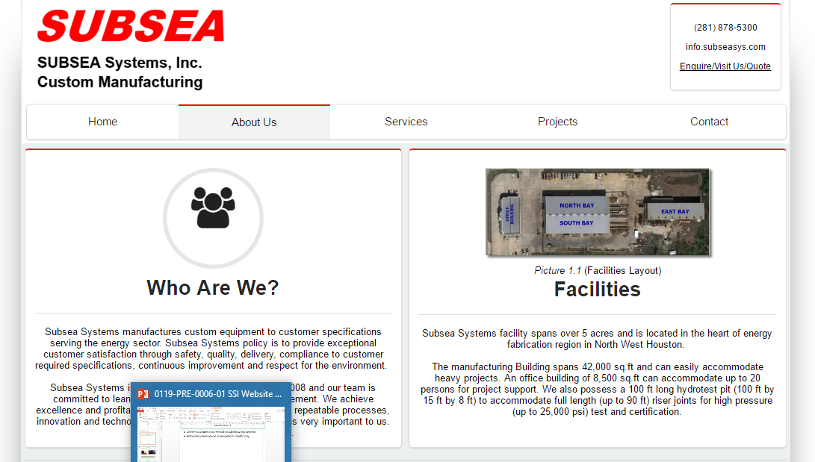
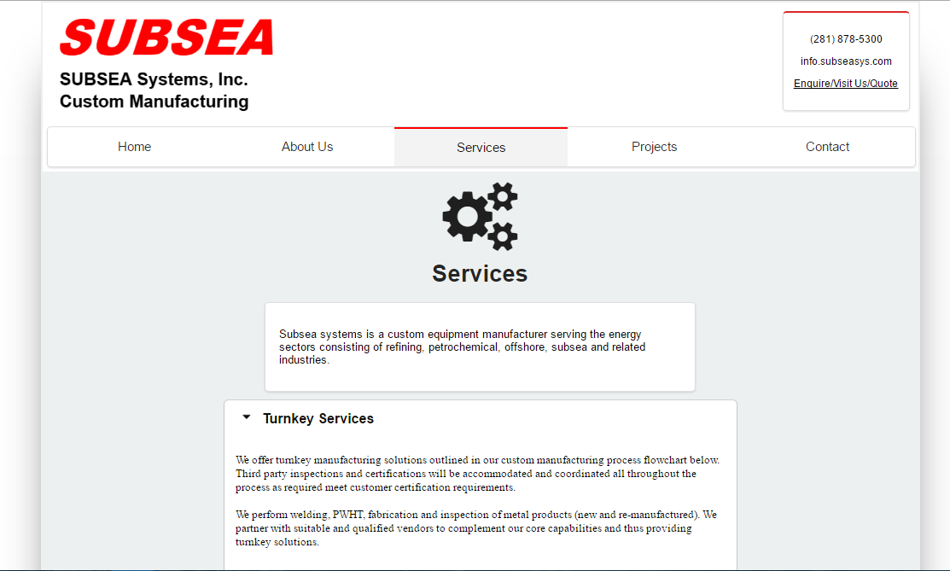
Comment-1
All the text present in the website should follow only one font.
All the text content should be formatted in “Justify” only.
The content is aligned to center in left side screenshot. On right side the font is changed in the highlighted area and it is aligned to left.

Slide 3
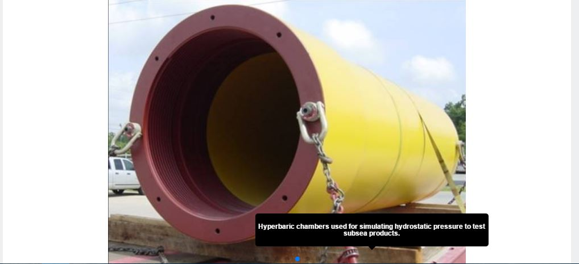

Comment-2
Please provide us options for writing the matter on the picture. We want to customize the background colour of the textbox, position of the text.
The position of the text are:
Right top corner
Left top corner
Right bottom corner
Left bottom corner
The below picture is a comparison of text blocking the chain of the component on left side, on right side the text doesn’t disturb the picture.

Slide 4
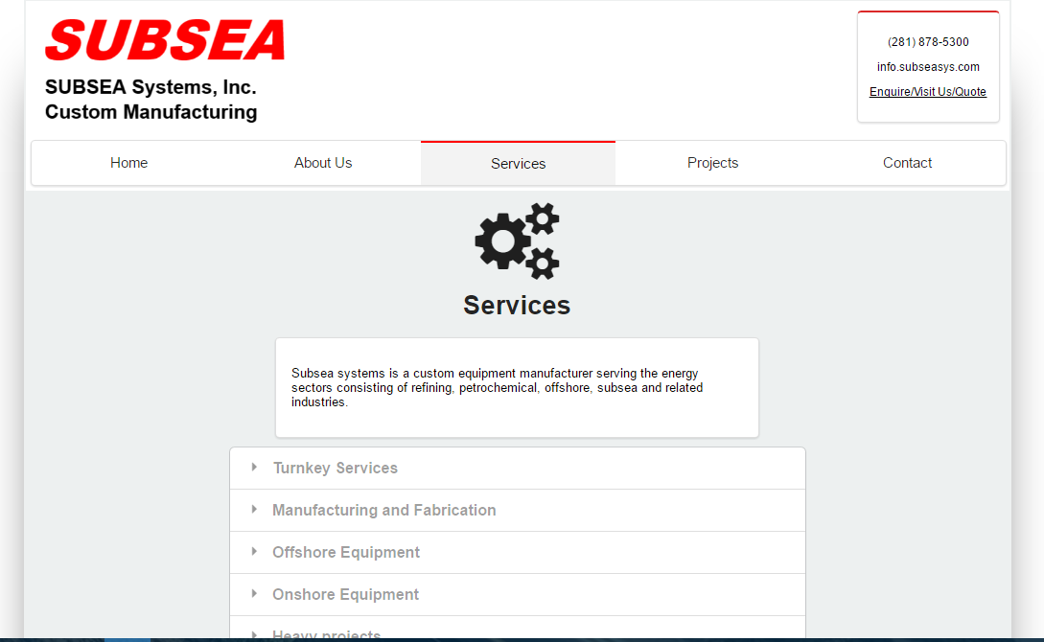
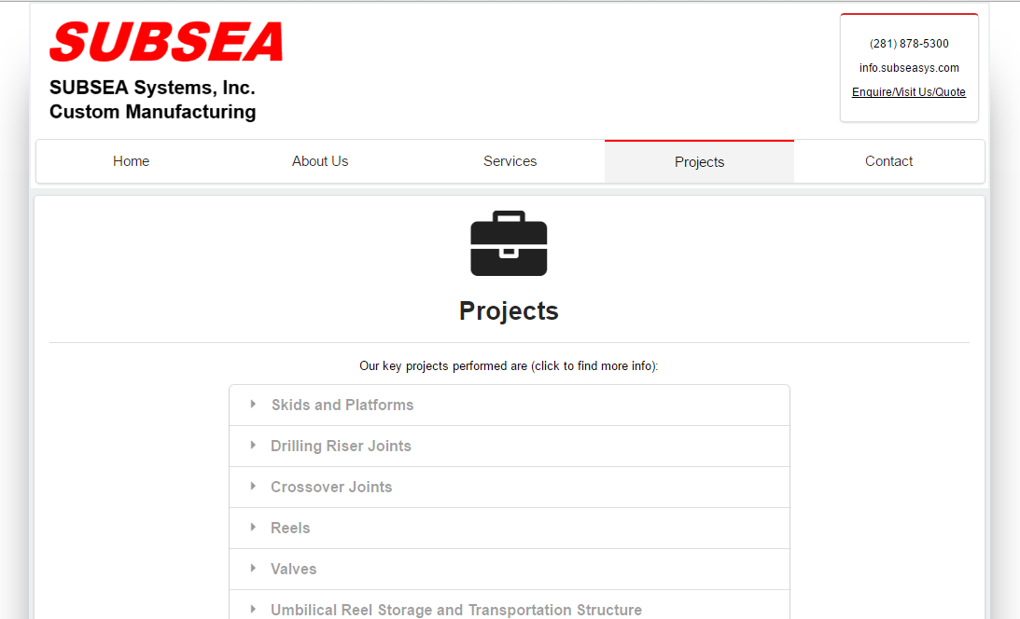
Comment-3
Please show the services page like the projects page. The back ground must be white instead of grey, need a differentiating line between the main content and remaining content.
Please write the content in the space created by red box.
Differencing line

Slide 5
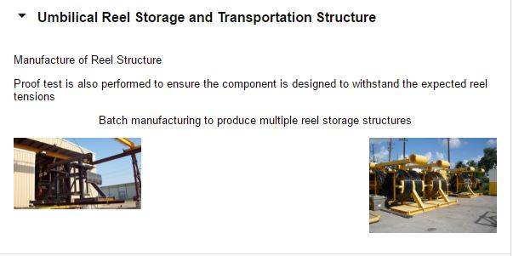
Comment-5
In projects page the images are not so consistent. The length and breadth of the images are different, please adjust the images accordingly and update the page.
Please highlight the images while we hover the mouse on image.
The below screenshot is an example for improper sizes of images. The picture on the left side is having small length where as the picture on the right hand side is looking good.

Slide 6
THANK YOU
For the opportunity to serve!

Slide 7
Document Revision History
01 | PRE-0001-01 Web report preview comments | 1 Sept 2016 |  | GSY | VA | ?
Rev | Description | Date |  | Author | Checked | Approved
Document No: |  |  | Client Ref:
PRE-0001-01 Web report preview comments |  |  | n/a

